Slide 1
INFORMATION SECURITY [3 0 0 3] ICT 3172:

Slide 2
Transport layer security provides end-to-end security services for applications that use a reliable transport layer protocol such as TCP.
To provide security services for transactions on the Internet.
.

Slide 3
When a customer shops online, following security services are desired:
The customer needs to be sure that the server belongs to the actual vendor, not an impostor. The customer does not want to give an impostor her credit card number (entity authentication).
The customer and the vendor need to be sure that the contents of the message are not modified during transmission (message integrity).
The customer and the vendor need to be sure that an impostor does not intercept sensitive information such as a credit card number (confidentiality).
.

Slide 4
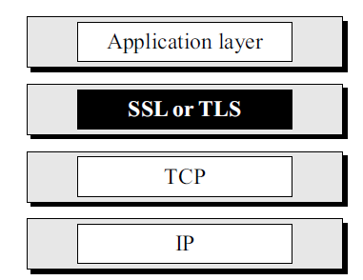
Two protocols are dominant today for providing security at the transport layer:
Secure Sockets Layer (SSL) Protocol
Transport Layer Security (TLS) Protocol.
The latter is actually an IETF version of the former.
position of SSL and TLS in the Internet model.
.

Slide 5
One of the goals of these protocols is to provide server and client authentication, data confidentiality, and data integrity.
If the server and client are capable of running SSL (or TLS) programs, then the client can use the URL https://… instead of http://… to allow HTTP messages to be encapsulated in SSL (or TLS) packets.
Credit card numbers can be safely transferred via the Internet.
.

Slide 6
17.1 SSL ARCHITECTURE
SSL is designed to provide security and compression services to data generated from the application layer.
SSL can receive data from any application layer protocol, but usually HTTP.
Data received from the application is compressed (optional), signed, and encrypted.
The data is then passed to a reliable transport layer protocol such as TCP.
Netscape developed SSL in 1994. Versions 2 and 3 were released in 1995.
Here discuss SSLv3.
.

Slide 7
Services
SSL provides several services on data received from the application layer.
Fragmentation : First, SSL divides the data into blocks of 214 bytes or less.
Compression : Each fragment of data is compressed using one of the lossless compression methods negotiated between the client and server.
This service is optional.
Message Integrity: To preserve the integrity of data, SSL uses a keyed-hash function to create a MAC.
Confidentiality: To provide confidentiality, the original data and the MAC are encrypted using symmetrickey cryptography.
Framing : A header is added to the encrypted payload. The payload is then passed to a reliable transport layer protocol.
.

Slide 8
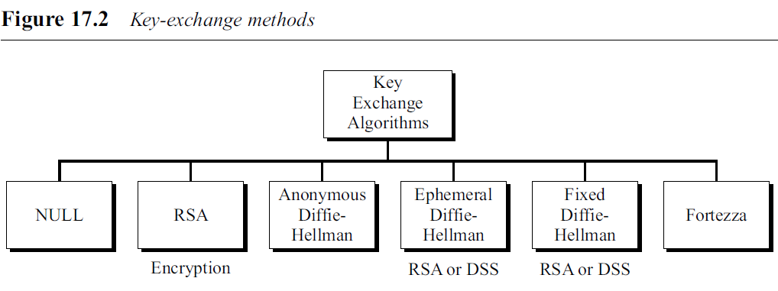
Key Exchange Algorithms
To exchange an authenticated and confidential message, the client and the server each need six cryptographic secrets (4 keys and 2 initialization vectors).
To create these secrets, one pre-master secret must be established between 2 parties.
SSL defines six key-exchange methods to establish this premaster secret:
.

Slide 9

NULL
There is no key exchange in this method.
No pre-master secret is established between the client and the server.
.

Slide 10
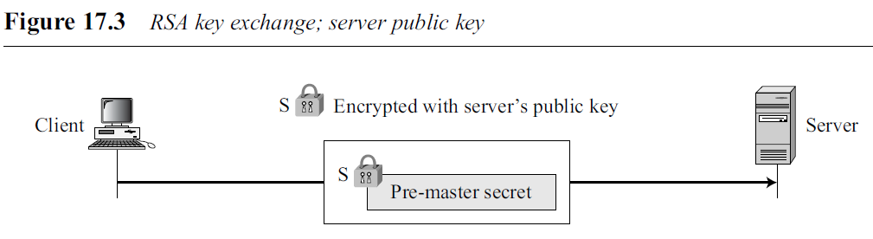
RSA
In this method, the pre-master secret is a 48-byte random number created by the client, encrypted with the server’s RSA public key, and sent to the server.
The server needs to send its RSA encryption/decryption certificate.
.

Slide 11
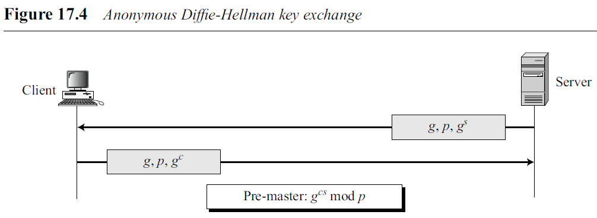
Anonymous Diffie-Hellman
Simplest and most insecure method.
Pre-master secret is established between client and server using Diffie-Hellman (DH) protocol.
The Diffie- Hellman half-keys are sent in plaintext.
It is called anonymous Diffie-Hellman because neither party is known to the other.
Most serious disadvantage of this method is the man-in-the-middle attack.
.

Slide 12
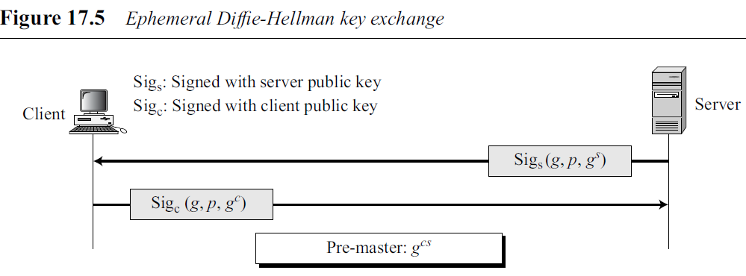
Ephemeral Diffie-Hellman
To thwart the man-in-the-middle attack, ephemeral Diffie-Hellman key exchange can be used.
Each party sends a Diffie-Hellman key signed by its private key.
The receiving party needs to verify the signature using the public key of the sender.
Public keys for verification are exchanged using either RSA or DSS digital signature certificates.
.

Slide 13
Fixed Diffie-Hellman
All entities in a group can prepare fixed Diffie-Hellman parameters (g and p).
Then each entity can create a fixed Diffie-Hellman half-key (g^{x}).
For additional security, each individual half-key is inserted into a certificate verified by a certification authority (CA).
In other words, the two parties do not directly exchange the half-keys; the CA sends the half-keys in an RSA or DSS special certificate.
When the client needs to calculate the pre-master, it uses its own fixed half-key and the server half-key received in a certificate.
The server does the same, but in the reverse order.
No key-exchange messages are passed in this method; only certificates are exchanged.
.

Slide 14
Fortezza
Fortezza (derived from the Italian word for fortress) is a registered trademark of the U.S. National Security Agency (NSA).
It is a family of security protocols developed for the Defense Department.
.

Slide 15
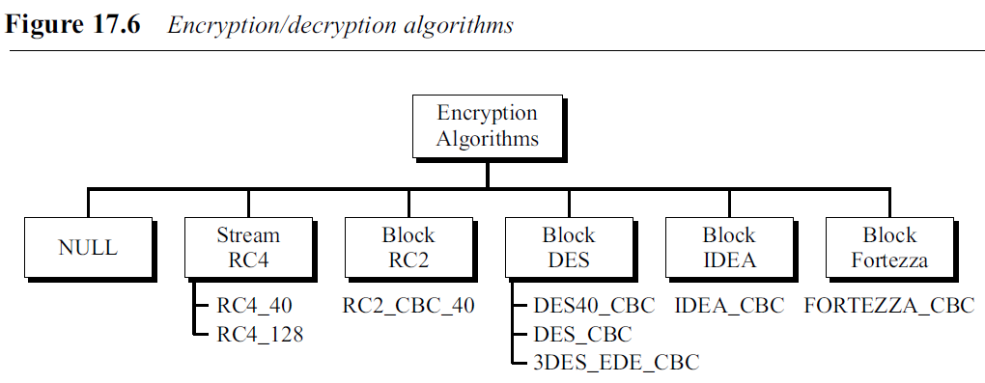
Encryption/Decryption Algorithms
There are several choices for the encryption/decryption algorithm.
All block protocols use an 8-byte initialization vector (IV) except for Fortezza, which uses a 20-byte IV.
.

Slide 16
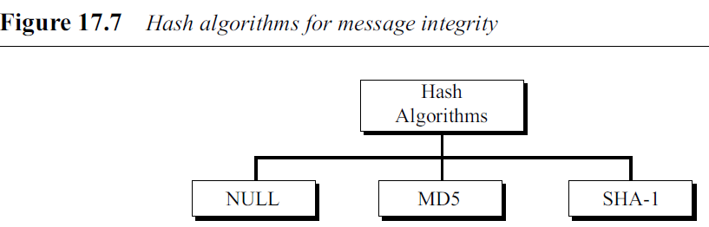
Hash Algorithms
SSL uses hash algorithms to provide message integrity (message authentication).
.

Slide 17
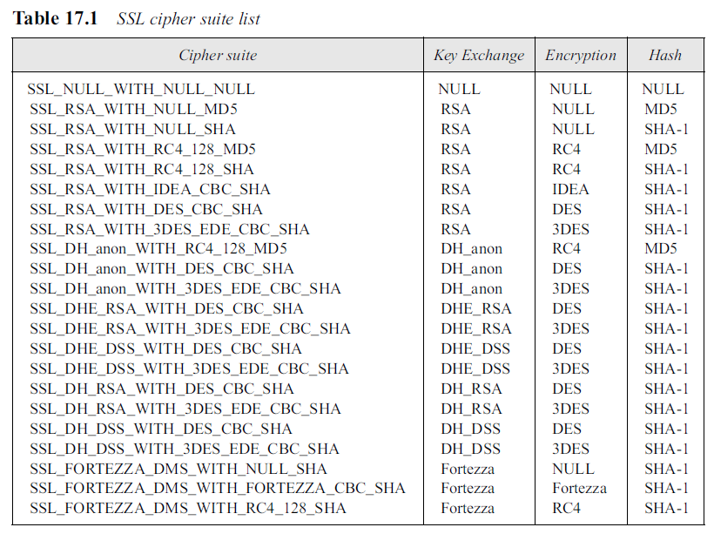
Cipher Suite
The combination of key exchange, hash, and encryption algorithms defines a cipher suite for each SSL session.
Table 17.1 shows the suites used in the United States.
.

Slide 18

Cipher Suite
Each suite starts with the term “SSL” followed by the key exchange algorithm.
The word “WITH” separates the key exchange algorithm from the encryption and hash algorithms. For example,
defines DHE_RSA (ephemeral Diffie-Hellman with RSA digital signature) as the key exchange with DES_CBC as the encryption algorithm and SHA as the hash algorithm.
Note that DH is fixed Diffie-Hellman, DHE is ephemeral Diffie-Hellman, and DH-anon is anonymous Diffie-Hellman.
.

Slide 19
Compression Algorithms
Compression is optional in SSLv3. No specific compression algorithm is defined for SSLv3.
Therefore, the default compression method is NULL.
However, a system can use whatever compression algorithm it desires.
.

Slide 20
Cryptographic Parameter Generation
To achieve message integrity and confidentiality, SSL needs 6 cryptographic secrets (4 keys and 2 IVs. )
The client needs one key for message authentication (HMAC), one key for encryption, and one IV for block encryption. The server needs the same.
The parameters are generated using the following procedure:
The client and server exchange two random numbers; one is created by the client and the other by the server.
2. The client and server exchange one pre-master secret using one of the key exchange algorithms we discussed previously.
.

Slide 21
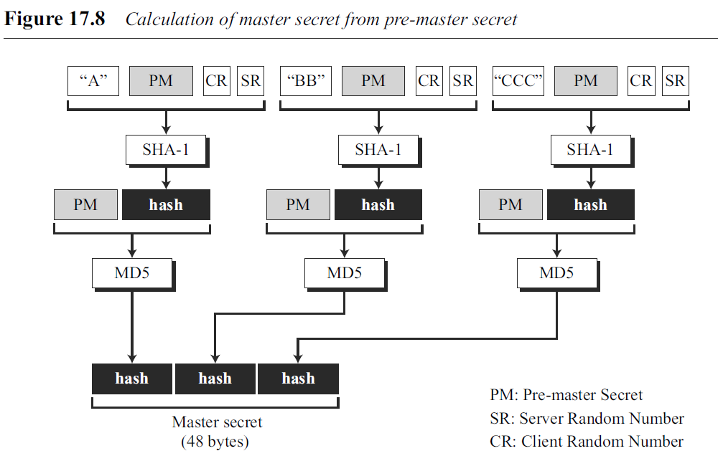
Cryptographic Parameter Generation
3. A 48-byte master secret is created from the pre-master secret by applying two hash functions (SHA-1 and MD5), as shown in Figure 17.8.
.

Slide 22
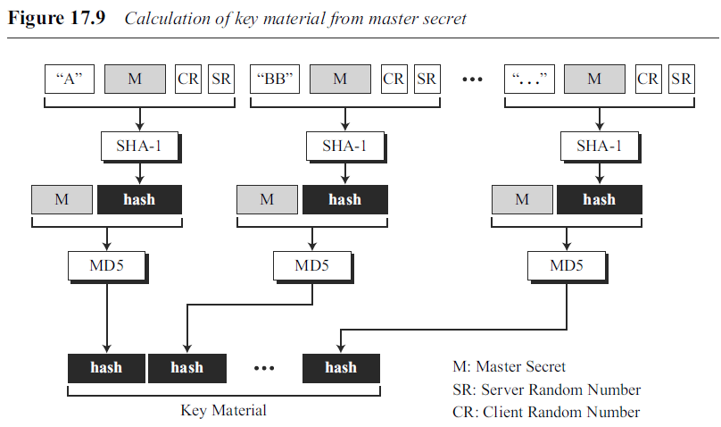
Cryptographic Parameter Generation
4. The master secret is used to create variable-length key material by applying the same set of hash functions and prepending with different constants as shown in Figure 17.9. The module is repeated until key material of adequate size is created.
Note that the length of the key material block depends on the cipher suite selected and the size of keys needed for this suite.
.

Slide 23
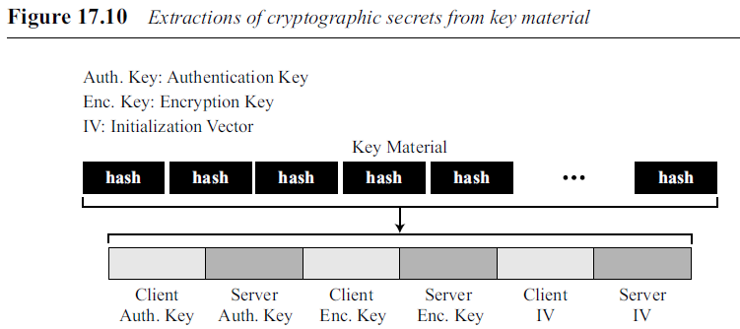
Cryptographic Parameter Generation
5. Six different keys are extracted from the key material, as shown in Figure 17.10
.

Slide 24
Sessions and Connections
SSL differentiates a connection from a session.
A session is an association between a client and a server.
After a session is established, the two parties have common information such as the session identifier, the certificate authenticating each of them (if necessary), the compression method (if needed), the cipher suite, and a master secret that is used to create keys for message authentication encryption.
A session can consist of many connections.
.

Slide 25
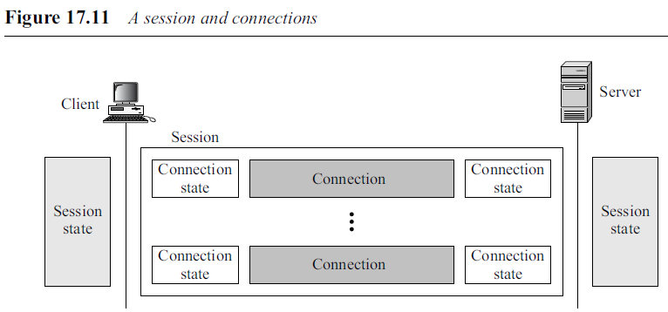

Sessions and Connections
.

Slide 26
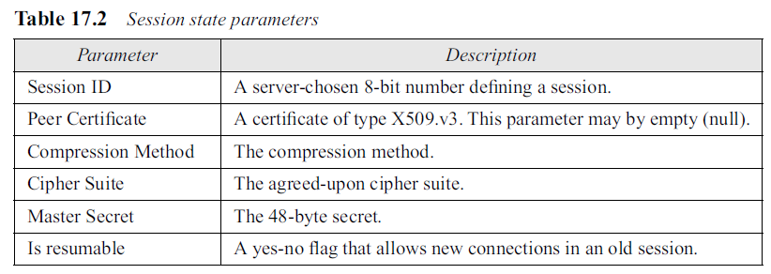
Sessions and Connections
Session State
A session is defined by a session state, a set of parameters established between the server and the client.
.

Slide 27
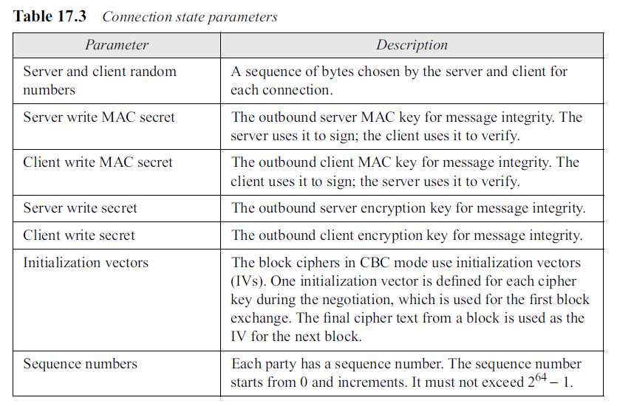
Sessions and Connections
Connection State
A connection is defined by a connection state, a set of parameters established between two peers.
.

Slide 28
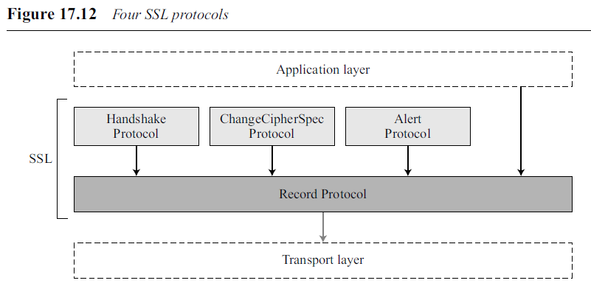
17.2 FOUR PROTOCOLS
SSL defines four protocols in two layers.
.

Slide 29
17.2 FOUR PROTOCOLS
Record Protocol carries messages from 3 other protocols as well as the data coming from the application layer.
The Handshake Protocol provides security parameters for the Record Protocol.
It establishes a cipher set and provides keys and security parameters.
Authenticates the server to the client and the client to the server if needed.
ChangeCipherSpec Protocol is used for signalling the readiness of cryptographic secrets.
The Alert Protocol is used to report abnormal conditions.
.

Slide 30
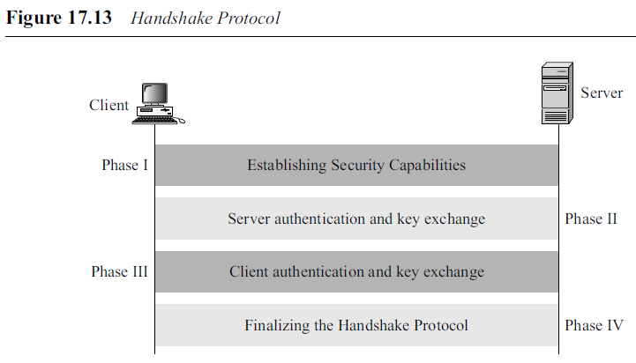
17.2 FOUR PROTOCOLS
Handshake Protocol
Uses messages to negotiate the cipher suite, to authenticate the server to the client and the client to the server if needed, and to exchange information for building the cryptographic secrets.
The handshaking is done in four phases.
.

Slide 31
Handshake Protocol
Phase I: Establishing Security Capability
Client and the server announce their security capabilities and choose those that are convenient for both.
In this phase, a session ID is established and the cipher suite is chosen.
Two random numbers are selected, one by the client and one by the server, to be used for creating a master secret.
Two messages are exchanged in this phase: ClientHello and ServerHello messages.
.

Slide 32
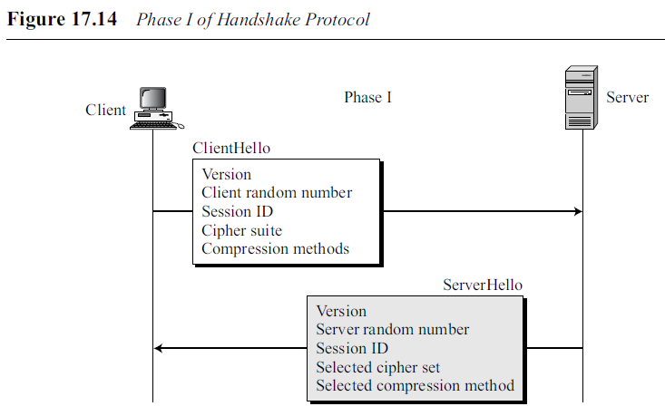
17.2 FOUR PROTOCOLS
Handshake Protocol
ClientHello
The client sends the ClientHello message. It contains the following:
a. The highest SSL version number the client can support.
b. A 32-byte random number (from the client) that will be used for master secret generation.
c. A session ID that defines the session.
d. A cipher suite that defines the list of algorithms that the client can support.
e. A list of compression methods that the client can support.
.

Slide 33
17.2 FOUR PROTOCOLS
Handshake Protocol
ServerHello
The server responds to the client with a ServerHello message. It contains the following:
a. An SSL version number. This number is the lower of two version numbers: the highest supported by the client and the highest supported by the server.
b. A 32-byte random number (from the server) that will be used for master secret generation.
c. A session ID that defines the session.
d. The selected cipher set from the client list.
e. The selected compression method from the client list.
.

Slide 34
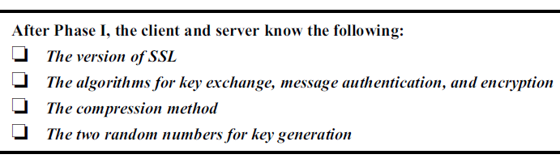
17.2 FOUR PROTOCOLS
Handshake Protocol
.

Slide 35
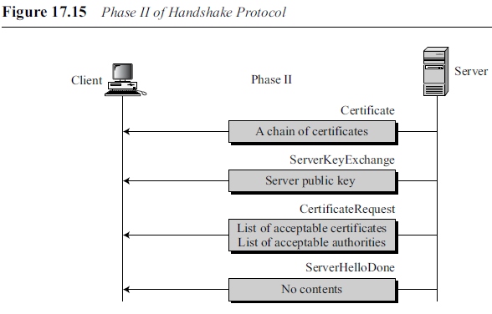
17.2 FOUR PROTOCOLS
Handshake Protocol
Phase II: Server Key Exchange and Authentication
In phase II, the server authenticates itself if needed.
The sender may send its certificate, its public key, and may also request certificates from the client.
At the end, the server announces that the serverHello process is done.
.

Slide 36
17.2 FOUR PROTOCOLS
Handshake Protocol
Phase II: Server Key Exchange and Authentication
Certificate If it is required, the server sends a Certificate message to authenticate itself. The message includes a list of certificates of type X.509. The certificate is not needed if the key-exchange algorithm is anonymous Diffie-Hellman.
ServerKeyExchange After the Certificate message, the server sends a ServerKey- Exchange message that includes its contribution to the pre-master secret. This message is not required if the key-exchange method is RSA or fixed Diffie-Hellman.
CertificateRequest The server may require the client to authenticate itself. In this case, the server sends a CertificateRequest message. The server cannot request a certificate from the client if it is using anonymous Diffie-Hellman.
ServerHelloDone The last message is the ServerHelloDone message, which is a signal to the client that Phase II is over and that the client needs to start Phase III.
.

Slide 37
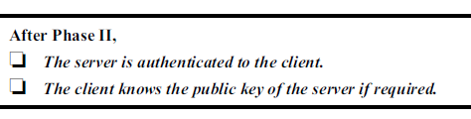
17.2 FOUR PROTOCOLS
Handshake Protocol
Phase II: Server Key Exchange and Authentication
.

Slide 38
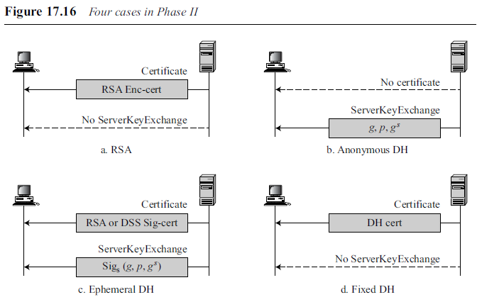
17.2 FOUR PROTOCOLS
Handshake Protocol
Phase II: Server Key Exchange and Authentication
.

Slide 39
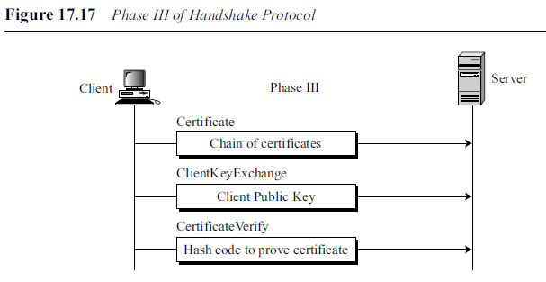
17.2 FOUR PROTOCOLS
Handshake Protocol
Phase III: Client Key Exchange and Authentication
Phase III is designed to authenticate the client.
Up to three messages can be sent from the client to the server, as shown in Figure 17.17.
.

Slide 40
17.2 FOUR PROTOCOLS
Handshake Protocol
Phase III: Client Key Exchange and Authentication
Certificate To certify itself to the server, the client sends a Certificate message. This message is sent only if the server has requested a certificate in Phase II.
ClientKeyExchange After sending the Certificate message, the client sends a Client- KeyExchange message, which includes its contribution to the pre-master secret. The contents of this message are based on the key-exchange algorithm used. If the method is RSA, the client creates the entire pre-master secret and encrypts it with the RSA public key of the server. If the method is anonymous or ephemeral Diffie-Hellman, the client sends its Diffie-Hellman half-key.
CertificateVerify If the client has sent a certificate declaring that it owns the public key in the certificate, it needs to prove that it knows the corresponding private key. This is needed to thwart an impostor who sends the certificate and claims that it comes from the client. The proof of private-key possession is done by creating a message and signing it with the private key. The server can verify the message with the public key already sent to ensure that the certificate actually belongs to the client.
.

Slide 41
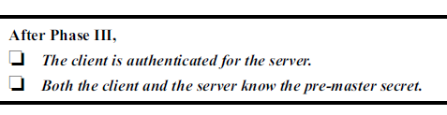
17.2 FOUR PROTOCOLS
Handshake Protocol
Phase III: Client Key Exchange and Authentication
.

Slide 42
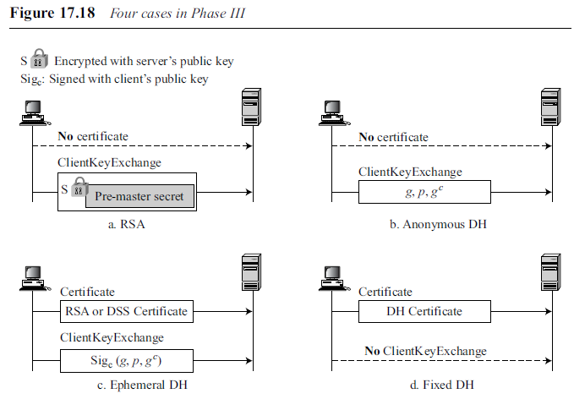
17.2 FOUR PROTOCOLS
Handshake Protocol
Phase III: Client Key Exchange and Authentication
.

Slide 43
17.2 FOUR PROTOCOLS
Handshake Protocol
Phase III: Client Key Exchange and Authentication
RSA. The ClientKeyExchange method includes the pre-master key encrypted with the RSA public key received in Phase II.
Anonymous DH. In the ClientKeyExchange message, the server sends the Diffie-Hellman parameters and its half-key. Note that the client is not authenticated to the server in this method.
Ephemeral DH. In this method, the client usually has a certificate. The server needs to send its RSA or DSS certificate (based on the agreed-upon cipher set). In the ClientKeyExchange message, the client signs the DH parameters and its halfkey and sends them. The client is authenticated to the server by signing the second message.
Fixed DH. In this method, the client usually sends a DH certificate in the first message. Note that the second message is empty in this method. The client is authenticated to the server by sending the DH certificate.
.

Slide 44
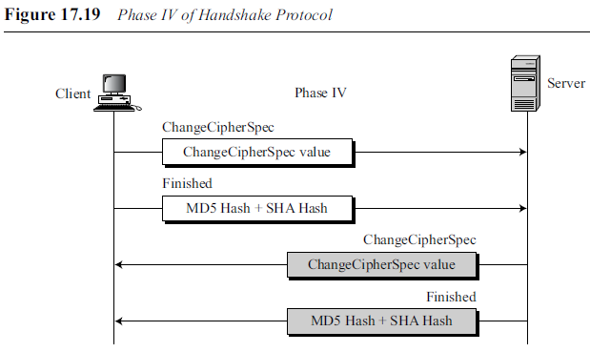
17.2 FOUR PROTOCOLS
Handshake Protocol
Phase IV: Finalizing and Finishing
In Phase IV, the client and server send messages to change cipher specification and to finish the handshaking protocol.
Four messages are exchanged in this phase, as shown in Figure 17.19.
.

Slide 45
17.2 FOUR PROTOCOLS
ChangeCipherSpec Protocol
The negotiation of the cipher suite and the generation of cryptographic secrets are formed gradually during the Handshake Protocol.
The sender and the receiver need two states. One state, the pending state, keeps track of the parameters and secrets. The other state, the active state, holds parameters and secrets used by the Record Protocol to sign/verify or encrypt/decrypt messages.
In addition, each state holds two sets of values: read (inbound) and write (outbound).
The ChangeCipherSpec Protocol defines the process of moving values between the pending and active states.
.

Slide 46
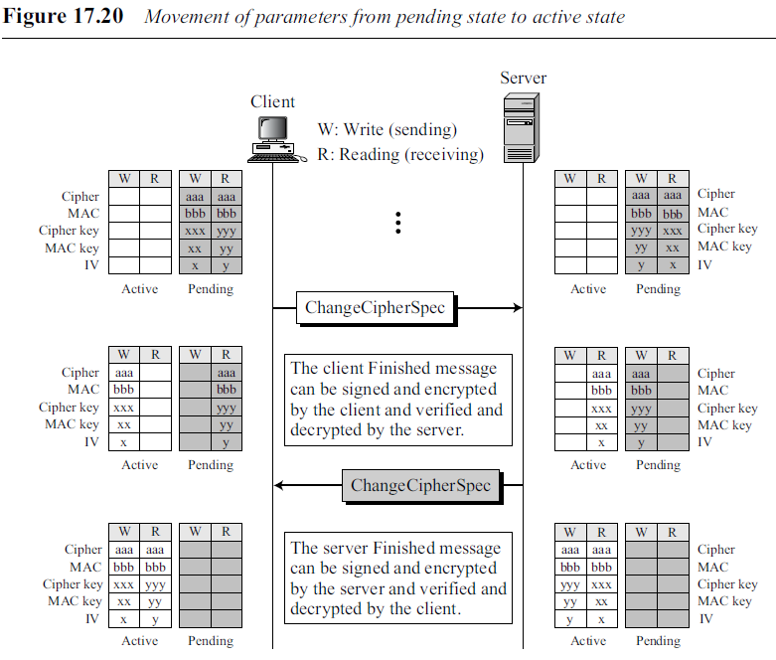
17.2 FOUR PROTOCOLS
ChangeCipherSpec Protocol
Figure 17.20 shows a hypothetical situation, with hypothetical values, to show the concept.
Only a few parameters are shown.
Before the exchange of any ChangeCipherSpec messages, only the pending columns have values.
.

Slide 47
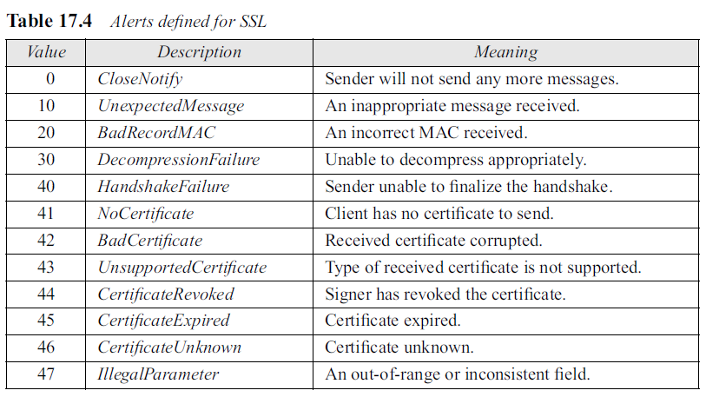
Alert Protocol
SSL uses the Alert Protocol for reporting errors and abnormal conditions.
It has only one message type, Alert message, that describes the problem and its level (warning or fatal).
.

Slide 48
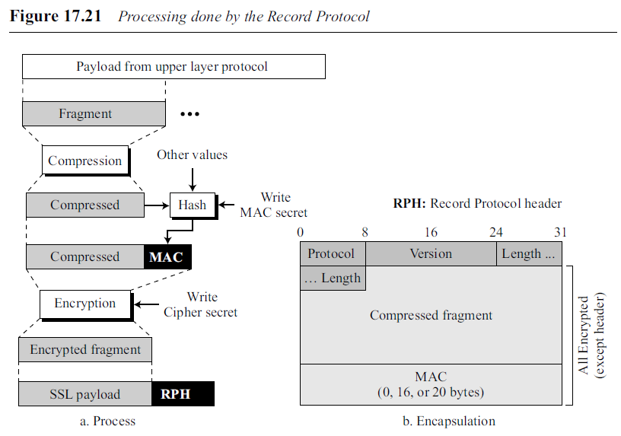
Record Protocol
The Record Protocol carries messages from the upper layer (Handshake Protocol, ChangeCipherSpec Protocol, Alert Protocol, or application layer).
The message is fragmented and optionally compressed; a MAC is added to the compressed message using the negotiated hash algorithm.
The compressed fragment and the MAC are encrypted using the negotiated encryption algorithm.
Finally, the SSL header is added to the encrypted message.
Figure 17.21 shows this process at the sender. The process at the receiver is reversed.
.

Slide 49
Record Protocol
This process can only be done when the cryptographic parameters are in the active state.
Fragmentation/Combination
At the sender, a message from the application layer is fragmented into blocks of 214 bytes, with the last block possibly less than this size. At the receiver, the fragments are combined together to make a replica of the original message.
Compression/Decompression
At the sender, all application layer fragments are compressed by the compression method negotiated during the handshaking. The compression method needs to be lossless.
.

Slide 50
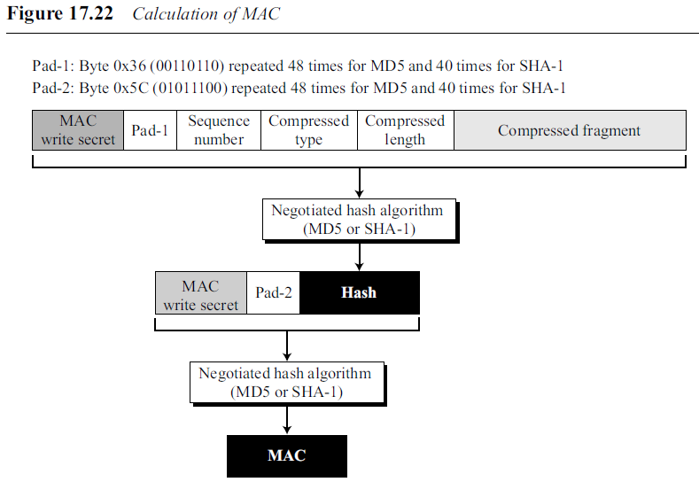
17.2 FOUR PROTOCOLS
Record Protocol
Signing/Verifying
At the sender, authentication method defined during the handshake (NULL, MD5, or SHA-1) creates a signature (MAC).
.

Slide 51
17.2 FOUR PROTOCOLS
Record Protocol
The hash algorithm is applied twice
First, a hash is created from the concatenations of the following values:
a. The MAC write secret (authentication key for the outbound message)
b. Pad-1, which is the byte 0x36 repeated 48 times for MD5 and 40 times for SHA-1
c. The sequence number for this message
d. The compressed type, which defines the upper-layer protocol that provided the compressed fragment
e. The compressed length, which is the length of the compressed fragment
f. The compressed fragment itself
Second, the final hash (MAC) is created from the concatenation of the following values:
The MAC write secret
b. Pad-2, which is the byte 0x5C repeated 48 times for MD5 and 40 times for SHA-1
c. The hash created from the first step
At the receiver, the verifying is done by calculating a new hash and comparing it to the received hash.
.

Slide 52
17.2 FOUR PROTOCOLS
Record Protocol
Encryption/Decryption
At the sender, the compressed fragment and the hash are encrypted using the cipher write secret.
At the receiver, the received message is decrypted using the cipher read secret
Framing/Deframing
After the encryption, the Record Protocol header is added at the sender. The header is removed at the receiver before decryption.
.

Slide 53
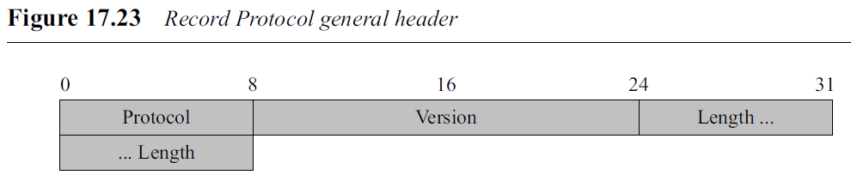
17.3 SSL MESSAGE FORMATS
The Record Protocol has a general header that is added to each message coming from the sources.
Protocol. This 1-byte field defines the source or destination of the encapsulated message. It is used for multiplexing and demultiplexing. The values are 20 (ChangeCipherSpec Protocol), 21 (Alert Protocol), 22 (Handshake Protocol), and 23 (data from the application layer).
Version. This 2-byte field defines the version of the SSL; one byte is the major version and the other is the minor. The current version of SSL is 3.0 (major 3 and minor 0).
Length. This 2-byte field defines the size of the message (without the header) in bytes.
.

Slide 54
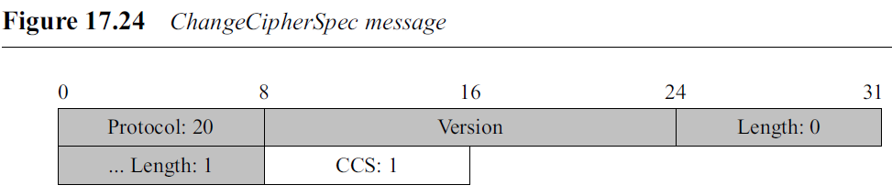
17.3 SSL MESSAGE FORMATS
ChangeCipherSpec Protocol
ChangeCipherSpec Protocol has one message, the Change-CipherSpec message.
Message is only one byte, encapsulated in the Record Protocol message with protocol value 20.
The one-byte field in the message is called the CCS and its value is currently 1.
.

Slide 55
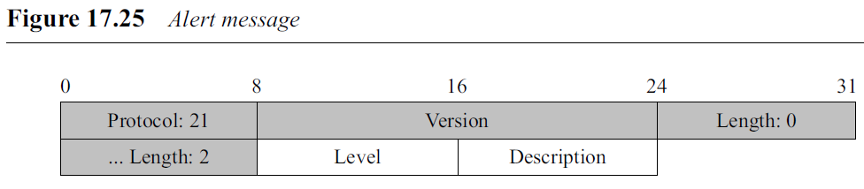
17.3 SSL MESSAGE FORMATS
Alert Protocol
The Alert Protocol, has one message that reports errors in the process.
The two fields of the Alert message are listed below.
Level. This one-byte field defines the level of the error. Two levels have been defined so far: warning and fatal.
Description. The one-byte description defines the type of error.
.

Slide 56
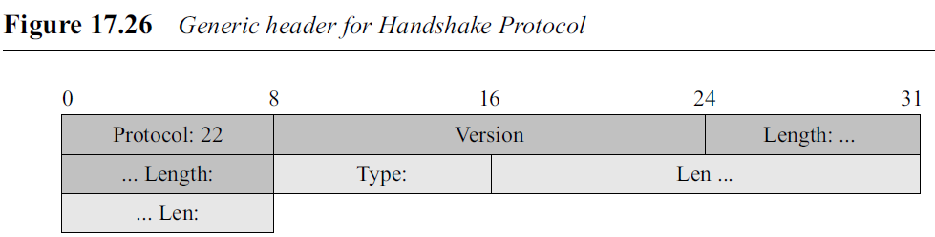
17.3 SSL MESSAGE FORMATS
Handshake Protocol
Several messages have been defined for the Handshake Protocol.
All of these messages have the four-byte generic header.
The figure shows the Record Protocol header and the generic header for the Handshake Protocol.
.

Slide 57
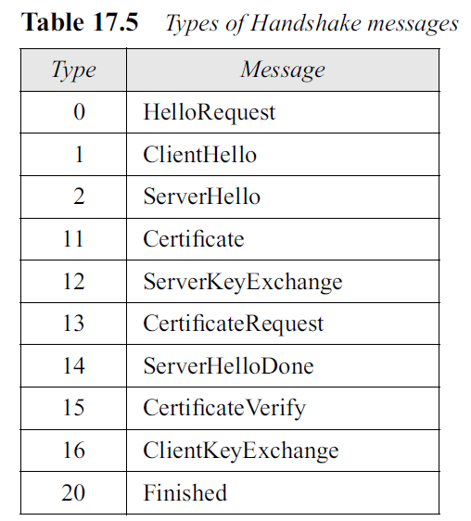
17.3 SSL MESSAGE FORMATS
Handshake Protocol
Type. This one-byte field defines the type of message. Ten types are
Length (Len). This 3-byte field defines the length of the message (excluding the length of the type and length field).
Need two length fields, one in the general Record header and one in the generic header for the Handshake messages : Record message may carry two Handshake messages at the same time if there is no need for another message in between.
.

Slide 58
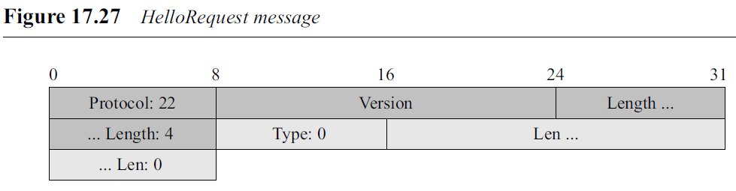
17.3 SSL MESSAGE FORMATS
Handshake Protocol
HelloRequest Message
The HelloRequest message, which is rarely used, is a request from the server to the client to restart a session.
.

Slide 59
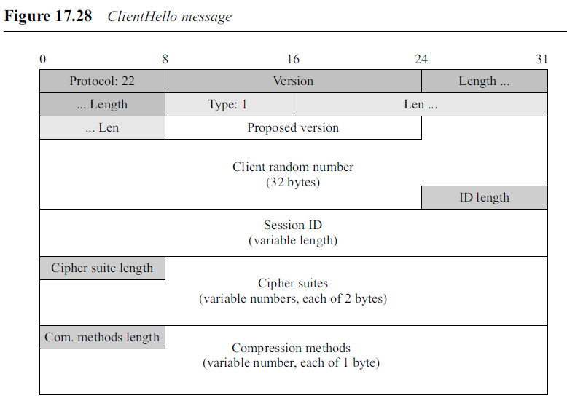
17.3 SSL MESSAGE FORMATS
Handshake Protocol
ClientHello Message
The ClientHello message is the first message exchanged during handshaking.
.

Slide 60
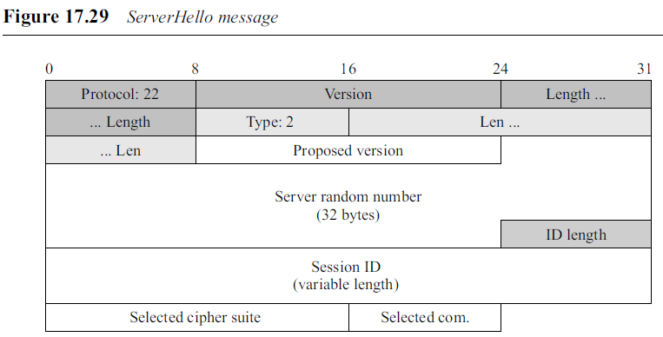
17.3 SSL MESSAGE FORMATS
Handshake Protocol
ServerHello Message
The ServerHello message is the server response to the ClientHello message. The format is similar to the ClientHello message, but with fewer fields.
.

Slide 61
17.3 SSL MESSAGE FORMATS
Handshake Protocol
ServerHello Message
The version field is the same. The server random number field defines a value selected by the server.
The session ID length and the session ID field are the same as those in the ClientHello message.
However, the session ID is usually blank (and the length is usually set to 0) unless the server is resuming an old session.
In other words, if the server allows a session to resume, it inserts a value in the session ID field to be used by the client (in the ClientHello message) if the client wishes to reopen an old session.
The selected cipher suite field defines the single cipher suite selected by the server from the list sent by the client. The compression method field defines the method
selected by the server from the list sent by the client.
.

Slide 62
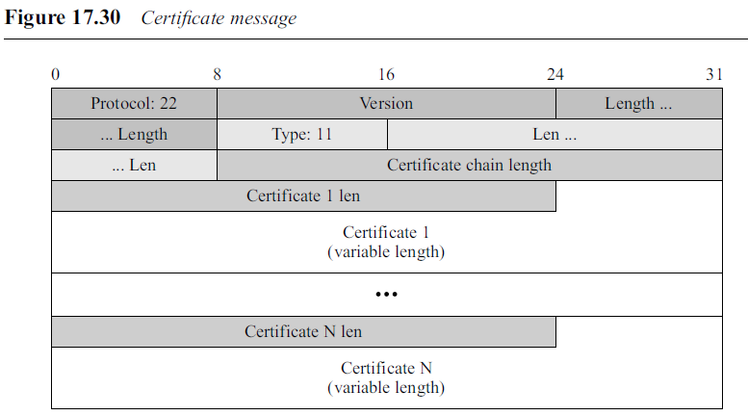
17.3 SSL MESSAGE FORMATS
Handshake Protocol
Certificate Message
Certificate message can be sent by the client or the server to list the chain of publickey certificates.
Certificate Chain Length. This three-byte field shows the length of the certificate chain.
Certificate Chain. This variable-length field lists the chain of public-key certificates that the client or the server carries. For each certificate, there are two sub-fields:
a. A three-byte length field
b. The variable-size certificate itself
.

Slide 63
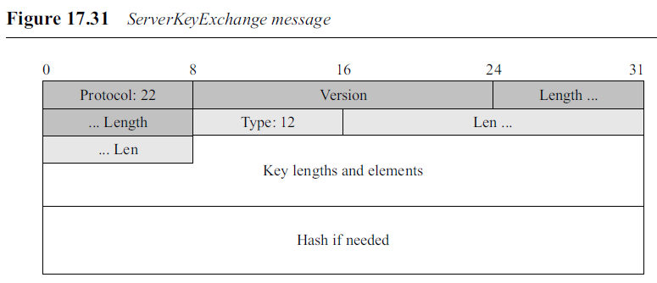
17.3 SSL MESSAGE FORMATS
Handshake Protocol
ServerKeyExchange Message
The ServerKeyExchange message is sent from the server to the client.
The message contains the keys generated by the server. The format of the message is dependent on the cipher suite selected in the previous message. The client that receives the message needs to interpret the message according to the previous information.
.

Slide 64
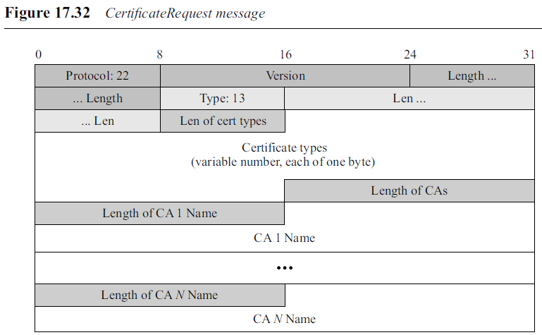
17.3 SSL MESSAGE FORMATS
Handshake Protocol
CertificateRequest Message
The CertificateRequest message is sent from the server to the client.
The message asks the client to authenticate itself to the server using one of the acceptable certificates and one of the certificate authorities named in the message.
.

Slide 65
17.3 SSL MESSAGE FORMATS
Handshake Protocol
CertificateRequest Message
Len of Cert Types. This one-byte field shows the length of the certificate types.
Certificates Types. This variable-length field gives the list of the public-key certificate types that the server accepts. Each type is one byte.
Length of CAs. This two-byte field gives the length of the certificate authorities .
Length of CA x Name. This two-byte field defines the length of the xth certificate authority name. The value of x can be between 1 to N.
CA x Name. This variable-length field defines the name of the xth certificate authority. The value of x can be between 1 to N.
.

Slide 66
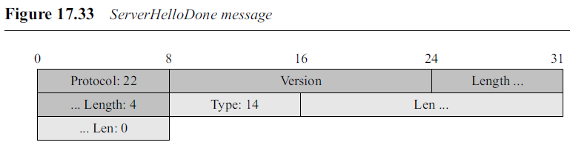
17.3 SSL MESSAGE FORMATS
Handshake Protocol
ServerHelloDone Message
The ServerHelloDone message is the last message sent in the second phase of handshaking. The message signals that phase II does not carry any extra information.
.

Slide 67
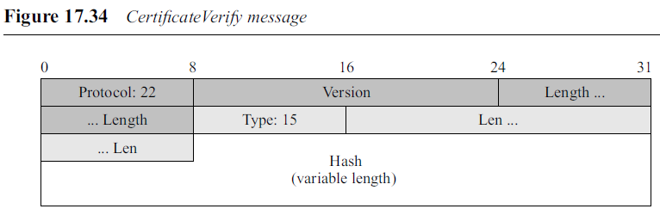
17.3 SSL MESSAGE FORMATS
Handshake Protocol
CertificateVerify Message
The CertificateVerify message is the last message of Phase III. In this message, the client proves that it actually owns the private key related to its public-key certificate. To do so, the client creates a hash of all handshake messages sent before this message, and signs them using the MD5 or SHA-1 algorithm based on the certificate type of the client.
If the client private key is related to a DSS certificate, then the hash is based only on the SHA-1 algorithm and the length of the hash is 20 bytes. If the client private key is related to an RSA certificate, then there are two hashes (concatenated), one based on MD5 and the other based on SHA-1. The total length is 16 + 20 = 36 bytes. Figure 17.35 shows the hash calculation.
.

Slide 68
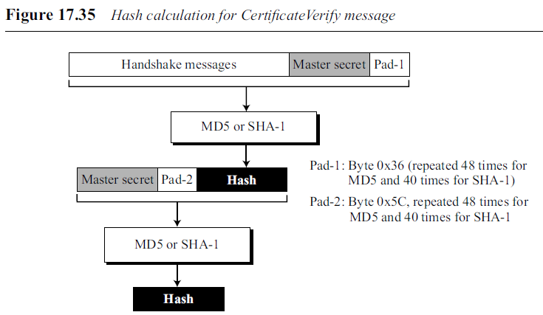
17.3 SSL MESSAGE FORMATS
Handshake Protocol
.

Slide 69
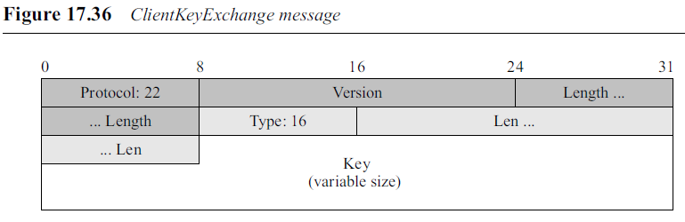
17.3 SSL MESSAGE FORMATS
Handshake Protocol
ClientKeyExchange Message
The ClientKeyExchange is the second message sent during the third phase of handshaking. In this message, the client provides the keys.
The format of the message depends on the specific key exchange algorithms selected by two parties.
.

Slide 70
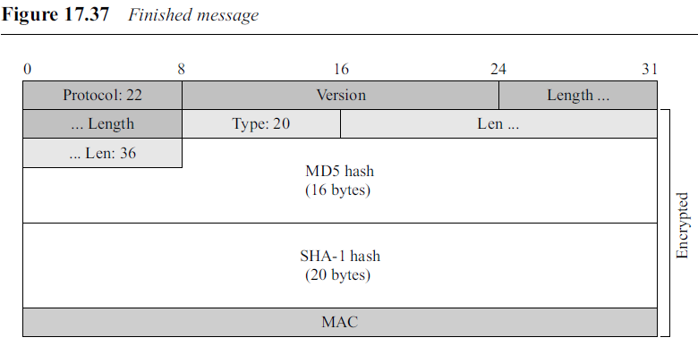
17.3 SSL MESSAGE FORMATS
Handshake Protocol
Finished Message
The Finished message shows that the negotiation is over. It contains all of the messages exchanged during handshaking, followed by the sender role, the master secret, and the padding. The exact format depends on the type of cipher suite used.
.

Slide 71
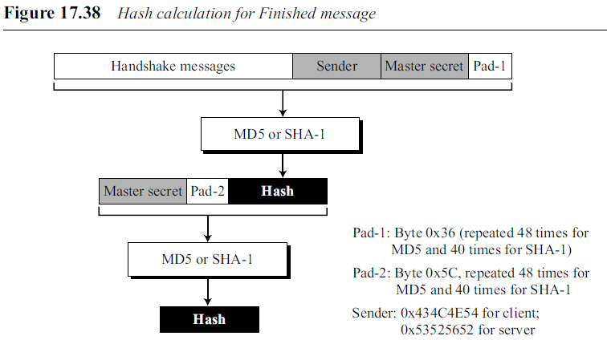
17.3 SSL MESSAGE FORMATS
Handshake Protocol
Finished Message
Figure 17.37 shows that there is a concatenation of two hashes in the message.
Figure 17.38 shows how each is calculated.
Note that when the client or server sends the Finished message, it has already sent the ChangeCipherSpec message. In other words, the write cryptographic secrets are in the active state. The client or the server can treat the Finished message like a data fragment coming from the application layer. The Finished message can be authenticated (using the MAC in the cipher suite) and encrypted (using the encryption algorithm in the cipher suite).
.

Slide 72
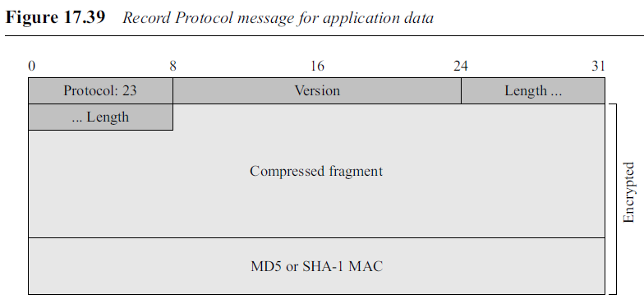
17.3 SSL MESSAGE FORMATS
Application Data
The Record Protocol adds a signature (MAC) at the end of the (possibly compressed) fragment coming from the application layer and then encrypts the fragment and the MAC.
After adding the general header with protocol value 23, the Record message is transmitted. Note that the general header is not encrypted.
.

Slide 73
17.4 TRANSPORT LAYER SECURITY
Transport Layer Security (TLS) protocol is the IETF standard version of the SSL protocol.
The two are very similar, with slight differences.
Discuss: differences between TLS and SSL protocols.
.

Slide 74
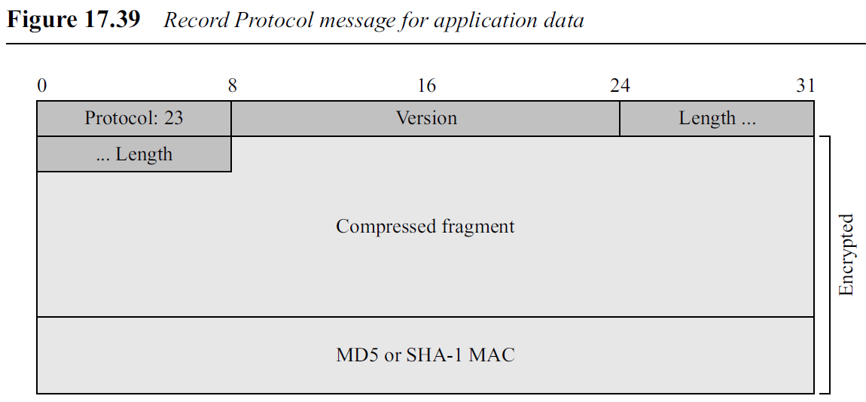
17.4 TRANSPORT LAYER SECURITY
Version
The first difference is the version number (major and minor).
The current version of SSL is 3.0; the current version of TLS is 1.0. In other words, SSLv3.0 is compatible with TLSv1.0.
TLS 1.3
.

Slide 75
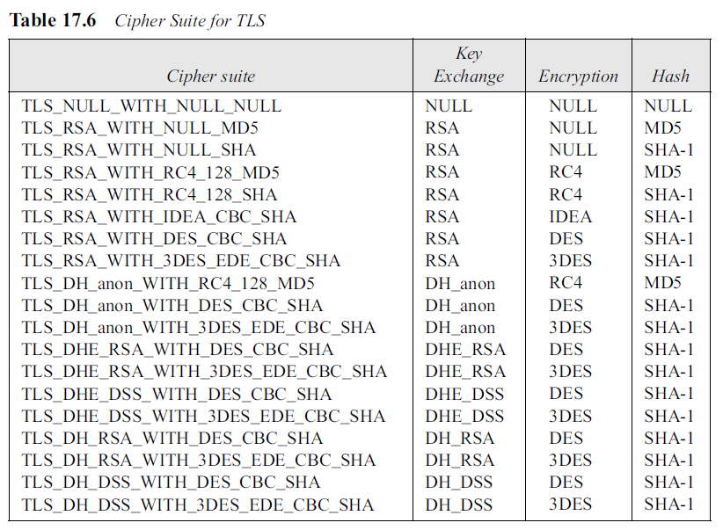
17.4 TRANSPORT LAYER SECURITY
Cipher Suite
Another minor difference between SSL and TLS is the lack of support for the Fortezza method.
TLS does not support Fortezza for key exchange or for encryption/decryption.
.

Slide 76
17.4 TRANSPORT LAYER SECURITY
Generation of Cryptographic Secrets
The generation of cryptographic secrets is more complex in TLS than in SSL.
TLS first defines two functions: the data-expansion function and the, pseudorandom function.
.

Slide 77
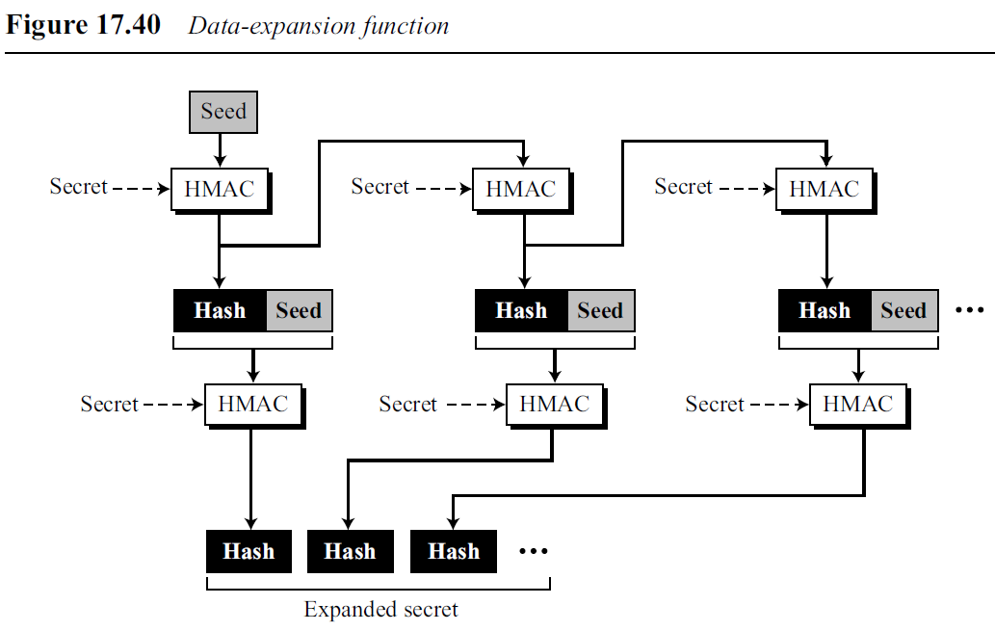
17.4 TRANSPORT LAYER SECURITY
Generation of Cryptographic Secrets
Data-Expansion Function
Data-expansion function uses a predefined HMAC (MD5 or SHA-1) to expand a secret into a longer one.
This function can be considered a multiple section function, where each section creates one hash value.
The extended secret is the concatenation of the hash values.
Each section uses two HMACs, a secret and a seed.
The data-expansion function is the chaining of as many sections as required.
To make the next section dependent on the previous, the second seed is actually the output of the first HMAC of the previous section.
.

Slide 78

17.4 TRANSPORT LAYER SECURITY
Generation of Cryptographic Secrets
Pseudorandom Function (PRF)
TLS defines a pseudorandom function (PRF) to be the combination of two data-expansion functions, one using MD5 and the other SHA-1.
PRF takes three inputs, a secret, a label, and a seed.
The label and seed are concatenated and serve as the seed for each data expansion function.
The secret is divided into two halves; each half is used as the secret for each data-expansion function.
The output of two data-expansion functions is exclusive ored together to create the final expanded secret.
Because the hashes created from MD5 and SHA-1 are of different sizes, extra sections of MD5-based functions must be created to make the two outputs the same size.
.

Slide 79
17.4 TRANSPORT LAYER SECURITY
Pre-master Secret
The generation of the pre-master secret in TLS is exactly the same as in SSL.
.

Slide 80

17.4 TRANSPORT LAYER SECURITY
Master Secret
TLS uses the PRF function to create the master secret from the pre-master secret.
This is achieved by using the pre-master secret as the secret, the string “master secret” as the label, and concatenation of the client random number and server random number as the seed.
.

Slide 81

17.4 TRANSPORT LAYER SECURITY
Key Material
TLS uses the PRF function to create the key material from the master secret.
This time the secret is the master secret, the label is the string “key expansion”, and the seed is the concatenation of the server random number and the client random number.
.

Slide 82

17.4 TRANSPORT LAYER SECURITY
Alert Protocol
TLS supports all of the alerts defined in SSL except for NoCertificate.
TLS also adds some new ones to the list. Table 17.7 shows the full list of alerts supported by TLS.
.

Slide 83

17.4 TRANSPORT LAYER SECURITY
Alert Protocol
.

Slide 84

17.4 TRANSPORT LAYER SECURITY
Handshake Protocol
TLS has made some changes in the Handshake Protocol.
Specifically, the details of the CertificateVerify message and the Finished message have been changed.
CertificateVerify Message
In SSL, the hash used in the CertificateVerify message is the two-step hash of the handshake messages plus a pad and the master secret.
TLS has simplified the process. Hash in the TLS is only over the handshake messages.
.

Slide 85

17.4 TRANSPORT LAYER SECURITY
Handshake Protocol
Finished Message
The calculation of the hash for the Finished message has also been changed.
TLS uses the PRF to calculate two hashes used for the Finished message.
.

Slide 86

17.4 TRANSPORT LAYER SECURITY
Record Protocol
The only change in the Record Protocol is the use of HMAC for signing the message.
TLS uses the MAC to create the HMAC. TLS also adds the protocol version (called Compressed version) to the text to be signed.
Figure 17.46 shows how the HMAC is formed.
.

Slide 87
END
.

